Slide 1
By TeachEzy @ teachezy.com

Slide 2
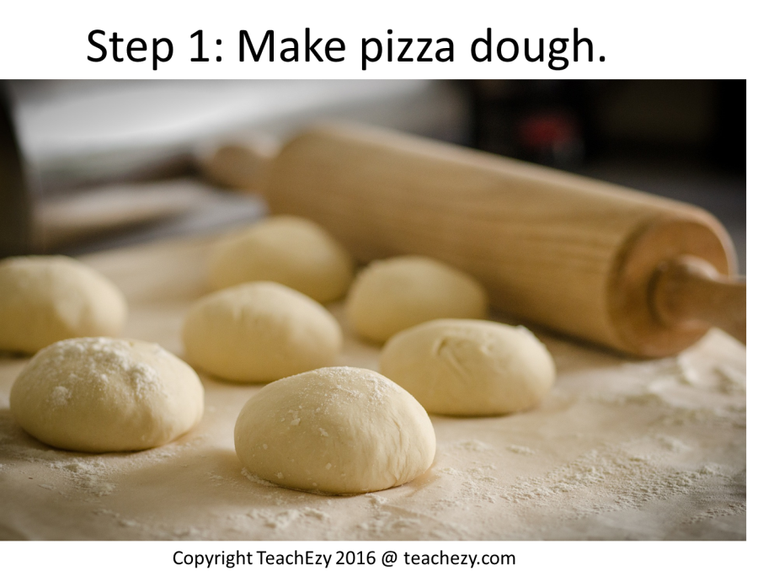

Slide 3
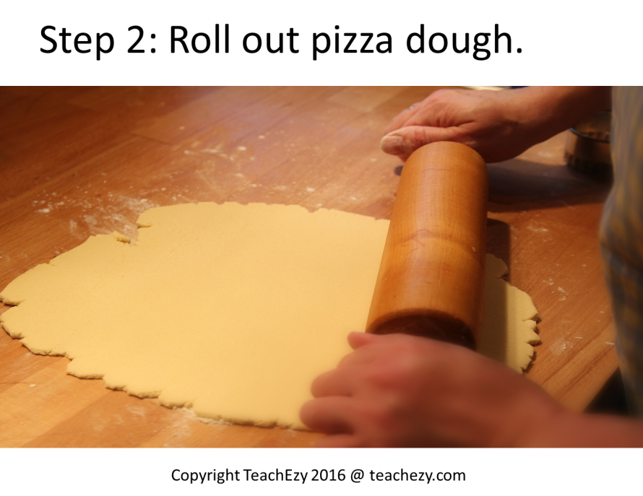
What will you do with the pizza dough now?

Slide 4
What is going on the pizza?
What preparation do you need to do?

Slide 5
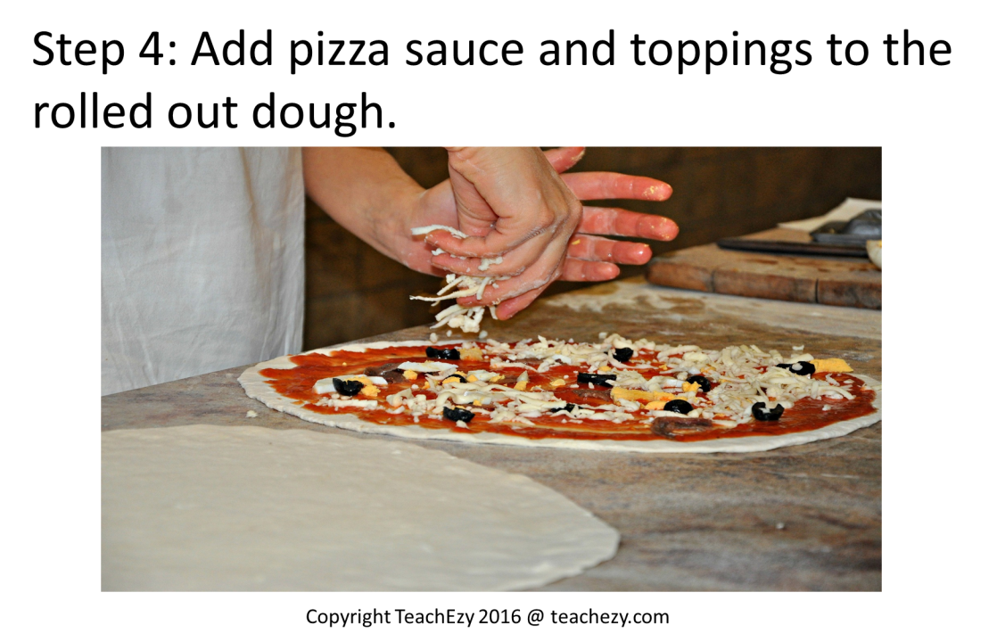
What are you going to do with the toppings?

Slide 6
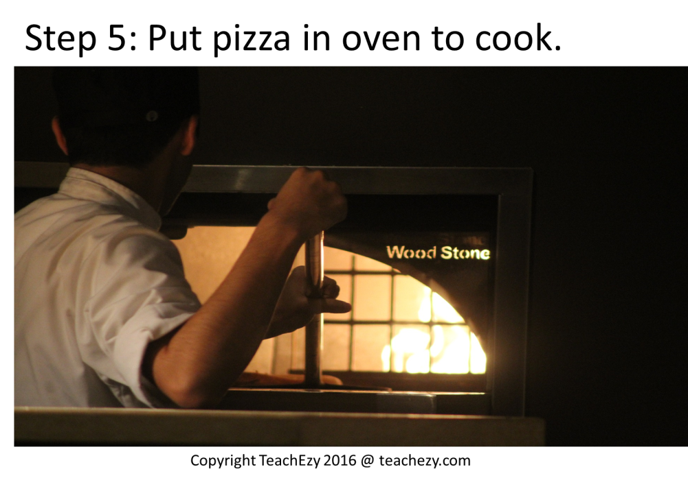
Now you have prepared the pizza, what is next?

Slide 7
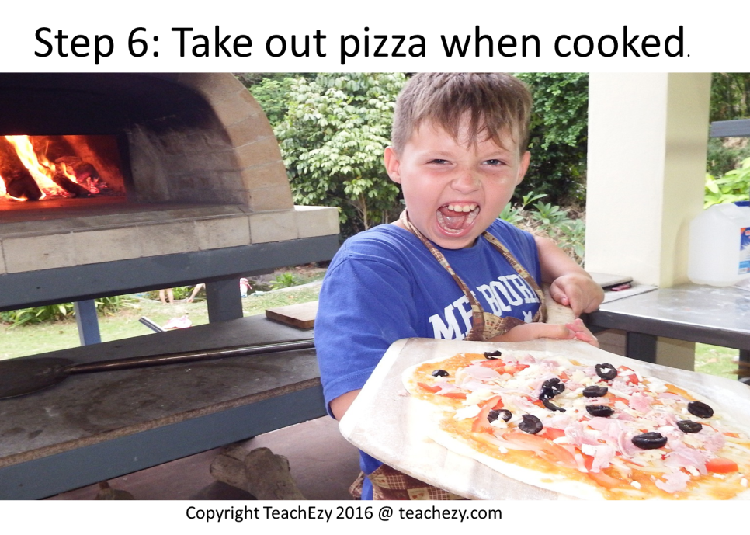
The bell on the oven goes. What should you do?

Slide 8
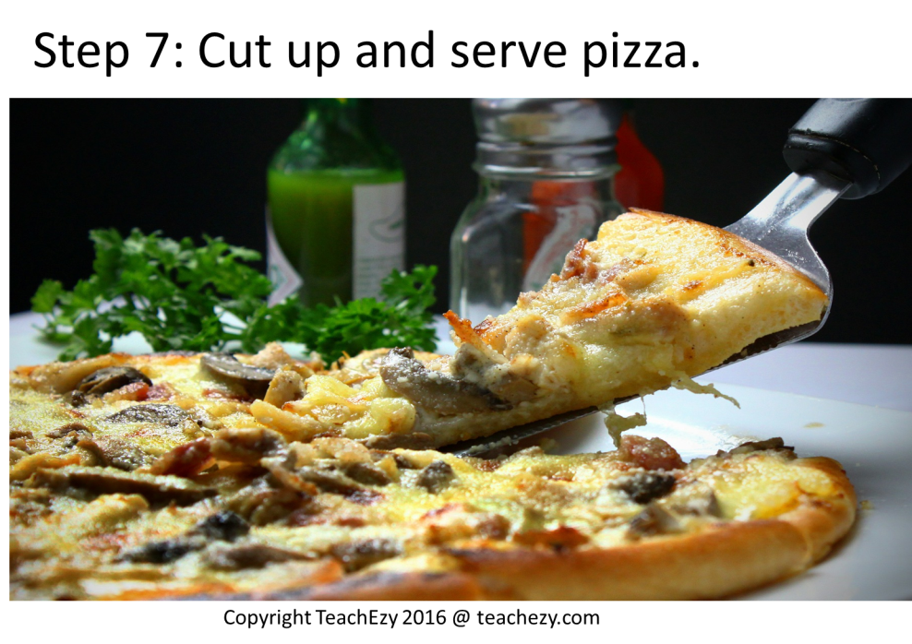
The pizza is cooked.
What do you do now?

Slide 9
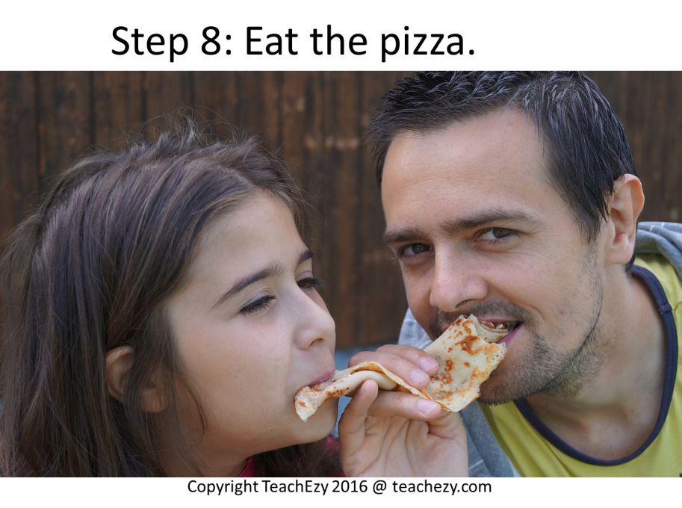
This is the best part!
What do you do last?

